Slide 1
E-Commerce Behaviour Data
Data Mining Project - Yurham Afif

Slide 2
Use case : E-Commerce Behaviour Data
Objective Statement:
Challenges:
Success Criteria:
Get Business insight of the daily web visit trend
Get Business insight of the daily visitors trend
Get Business insight of the web conversion performance
Source Data: E-Commerce Behavior Data Oct 2019
Large size of data, can not maintain by excel spreadsheet.
Method/Analytic Technique:
Descriptive analysis
Graph analysis
Explore the behaviour of ecommerce business insight.
Expected Outcome
the trend of the daily web visit
the trend of the daily visitors
the performance of the web conversion

Slide 3
Business understanding
What’s e-commerce?
What can we grasp?
E-commerce (electronic commerce) business is an online interaction of commodities transaction (buying or selling).
Every single transaction we made on e-commerce are producing a large amount of data, which termed as behavioural data, as human behaviour is a major source of data in the current digital economy.
So, behavioural data is important for predict and enhance the performance of a company. Based on Kaggle's dataset link given above, we could determine some business question using the data that we need to answer, such as:
How is the trend of the daily web visit?
How is the trend of the daily visitors?
How is the performance of the web conversion?

Slide 4
Data Understanding
Behaviour data for October 2019 from a large multi-category online store. Each row in the file represents an event. All events are related to products and users. Each event is like many-to-many relation between products and users. The file structure are given below.
Property | Description
event_time | Time when event happened at (in UTC).
event_type | Only one kind of event: purchase.
product_id | ID of a product
category_id | Product's category ID
category_code | Product's category taxonomy (code name) if it was possible to make it. Usually present for meaningful categories and skipped for different kinds of accessories.
brand | Downcased string of brand name. Can be missed.
price | Float price of a product. Present.
user_id | Permanent user ID.
** user_session** | Temporary user's session ID. Same for each user's session. Is changed every time user come back to online store from a long pause.

Slide 5
Data Preparation and Cleansing
Preparation
Cleansing
Data used: Oct 2019.csv
Code Used: Python Version: 3.7.6
Packages: Pandas, Numpy and Matplotlib.
Check for each column and find if any column is redundant or useless.
Check for missing values.
Check if the data format is already suitable for algorithm.
Check for value that are not consistent with general common sense

Slide 6
Exploratory Data Analysis

Slide 7
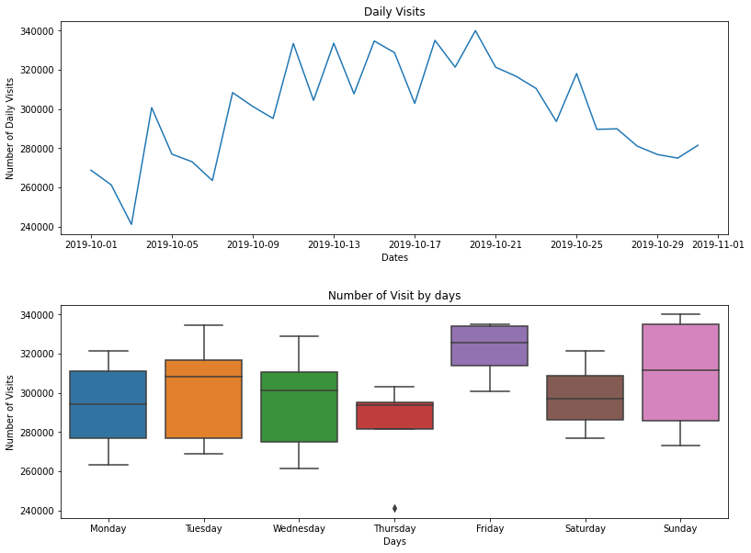
Campaign Pop when Begin and End a Month!
How is the trend of the daily web visit?
High visit are mostly happened in the middle of October and on Sunday every week. It seems like customers tend to hold their desire to open the web in first and last week of the month. The business team are suggested to provide promising campaign during that moment, especially on Sunday.

Slide 8
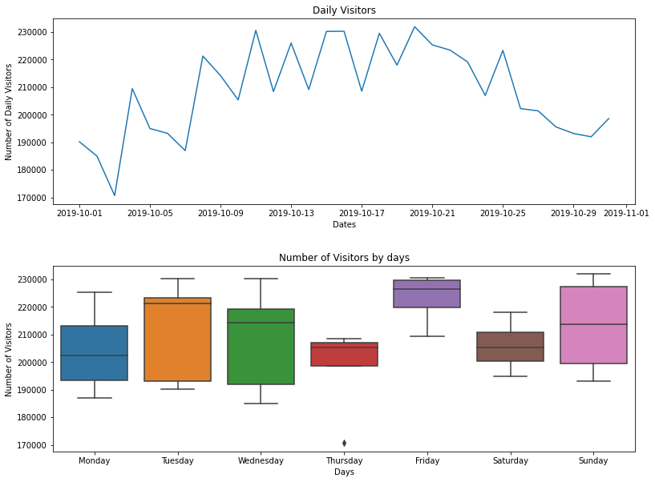
Tuesday and Friday also Promising!
How is the trend of the daily visitors?
The visitor pattern are not quite different with the visit count, but higher intensity of visitor are happened on Tuesday and Friday. This also a promising day to increase sale by add some campaign during weekdays.

Slide 9
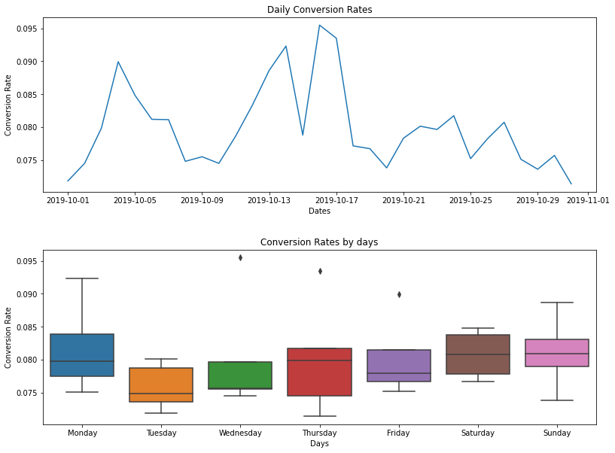
Focus on Visit Pattern!
How is the performance of the web conversion?
Most sales are happened in the beginning and middle of October. Sunday and Monday are the most significant day for checkout the cart, though there is no quite significant difference between other days in a week. Business team shall keep their focus on attracting visitors based on their visit pattern.

Slide 10
Conclusion?
Create Event to Begin and End a Month!
Tuesday and Friday also Promising!
Focus on Visit Pattern!
Campaign Pop!

Slide 11



E-Commerce Behaviour Data
Data Mining Project - Yurham Afif
yurhamafif.edu@gmail.com
Yurham Afif
itsapep

